Slide 1
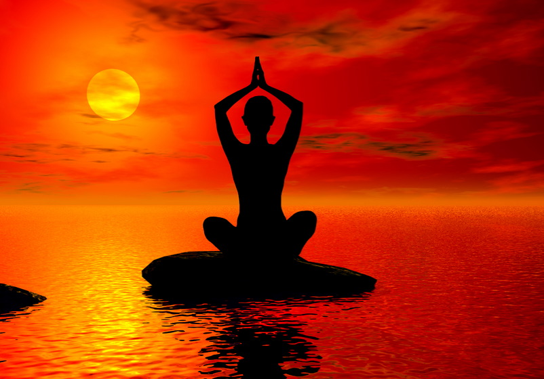
WELCOME
TOPIC :- YOGA

Slide 2
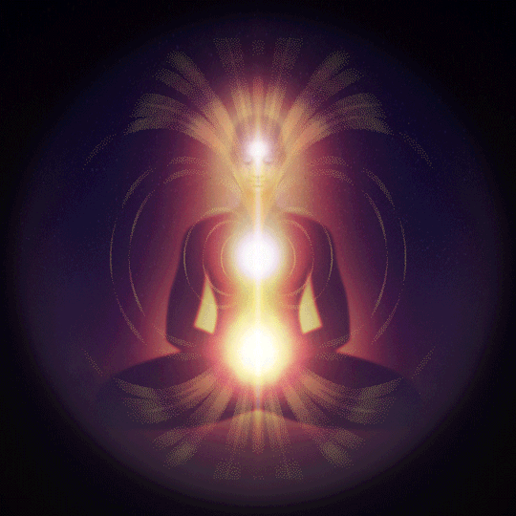
BY :- RAJESH KUMAR SINGH

Slide 3





Slide 4


Slide 5
What is Healthy means………

Slide 6
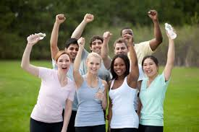
Happy..
Disease Free body
Tension free Mind
Any thing else……..

Slide 7
?
What is the Solution

Slide 8
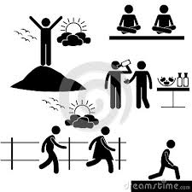
Many Solutions are there…

Slide 9
Among those One is…
Yoga

Slide 10
Astanga Yoga
(eight fold Yoga)
Yama
Niyama
Asana
Pranayama
Pratyahara
Dharana
Dhyana
Samadhi

Slide 11
Astanga Yoga
(eight fold Yoga)
Yama
(The five Commandments for Social Discipline)
1. Ahimsa (Non-violence),
2. Satya (Truth)
3. Asteya ( Non-stealing)
4. Aparigraha (None-accumulation of wealth etc..)
5. Brahmacharya (Continence / Celibacy)
The society is at peace if these social restraints are practiced by every citizen.

Slide 12
Yoga for Health
Objectives of the session
To give a simplified view on Yoga for your adoptability.
15 min effective exercise to keep yourself healthy and stress free.
Tips and Techniques to get rid of common problems.

Slide 13
Simplified View
Wake up : Early Morning
Clean up : Drink 1.5 Lt. warm water .
Warm up : Surya Namaskaras
Stretch up: Asanas
Fresh up : Pranayama
Joy up : Meditation

Slide 14
Agenda
Surya Namaskaras

Slide 15
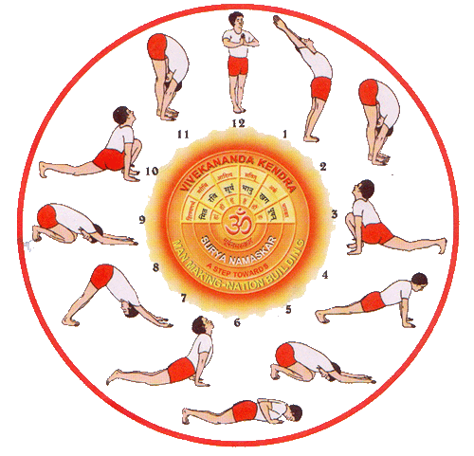
Different postures of Surya Namaskaras

Slide 16
Position 1 - Pranamasana (Prayer Pose)
Breath : Exhale
Chakra : Anahata
Surya mantra: Om Mitraya Namaha
Muscles :postural, from soles of feet
to crown of the head
Organs/glands:cerebellum, thymus
Benefits: establishes balance,
concentration, calmness

Slide 17
Position 2 - Hasta Utthanasana
(Raised Arm Pose)
Breath : Inhale
Chakra : Vishuddhi
Surya mantra : Om Ravaye Namaha
Muscles: back, shoulders, arms,
chest, abdomen
Organs/glands: kidneys, intestines, lungs, adrenal glands , thyroid / parathyroid
Benefits opening emotionally, corrects poor posture

Slide 18
Position 3 - Padahastasana (Hand to Feet Pose)
Breath Exhale
Chakra Swadhisthana
Surya mantra Om Suryaya Namaha
Muscles hamstrings, buttocks,
back, neck, shoulders
Organs/glands GIT, kidneys, thyroid
Benefits improves digestion, circulation & respiration

Slide 19
Position 4 - Ashwa Sanchalanasana (Equestrian Pose)
Breath inhale
Chakra Ajna
Surya mantra Om Bhanave Namaha
Muscles legs, buttocks, abdomen, thorax and neck
Organs cerebellum
Benefits sense of balance, centre of gravity

Slide 20
Position 5 - Parvatasana (Mountain Pose)
Breath exhale
Chakra Vishuddhi
Surya mantra Om Khagaya Namaha
Muscles legs, buttocks, abdomen, thorax and neck
Organs cerebellum, tones spinal nerves
Benefits sense of balance, centre of gravity, improves circulation

Slide 21
Position 6 - Ashtanga Namaskara (Salute With 8 Points)
Breath retain breath (out)
Chakra Manipura
Surya mantra Om Pushne Namaha
Muscles legs, buttocks, abdomen, thorax and neck, shoulders, forearms
Organs recharges solar plexus, stimulates metabolism, Adrenal glands, Kidneys
Benefits strengthening and nourishing the body

Slide 22
Position 7 - Bhujangasana (Cobra Pose)
Breath inhale
Chakra Swadhisthana
Surya mantra Om Hiranya Garbhaya Namaha
Muscles stretches abdomen ms,anterior neck ms strengthens posterior back ms
Organs kidney and liver, digestive system
Benefits Good for asthma, constipation

Slide 23
Position 8 - Parvatasana (Mountain Pose)
Breath exhale
Chakra Vishuddhi
Surya mantra Om Marichaye Namaha
Muscles legs, buttocks, abdomen, back and neck
Organs thyroid
Benefits stretches spinal nerves, circulation

Slide 24
Position 9 - Ashwa Sanchalanasana (Equestrian Pose)
Breath inhale
Chakra Ajna
Surya mantra Om Adityaya Namaha
Muscles stretches hip flexor ms, strengthens quads loosens tight hips
Organs massages abdominal organs, nervous system
Benefits nervous system, pineal gland

Slide 25
Position 10 - Padahastasana (Hand to Feet Pose)
Breath Exhale
Chakra Swadhisthana
Surya mantra Om Savitre Namaha
Muscles stretches hamstrings, buttocks,
back, Posterior neck, shoulders ms
Organs/glands GIT, kidneys, thyroid
Benefits improves digestion, circulation & respiration

Slide 26
Position 11 - Hasta Utthanasana (Raised Arm Pose)
Breath Inhale
Chakra Vishuddhi
Surya mantra Om Arkaya Namaha
Muscles back, shoulders, arms,chest, abdomen
Organs/glands kidneys, intestines, lungs,adrenal glands thyroid/parathyroid,
Benefits - opening emotionally, orrects poor posture

Slide 27
Position 12 - Pranamasana (Prayer Pose)
Breath Exhale
Chakra Anahata
Surya mantra Om Bhaskaraya Namaha
Muscles postural, from soles of feet to crown of the head
Organs/glands cerebellum, thymus
Benefits sense of balance, centre of gravity, concentration

Slide 28
THANK YOU

